Slide 1
Steam Games Database

Slide 2
System Description
Our project is a Database that consists of several games found on Steam, a popular game platform.
Users can browse for games, read or post reviews, and wishlist games.
Users will have their own accounts which have their wishlisted and reviewed games.
Users can also check what games are currently on sale.
Github link: https://github.com/BreadsRL/SteamDB

Slide 3
Use-Case Diagram

Slide 4
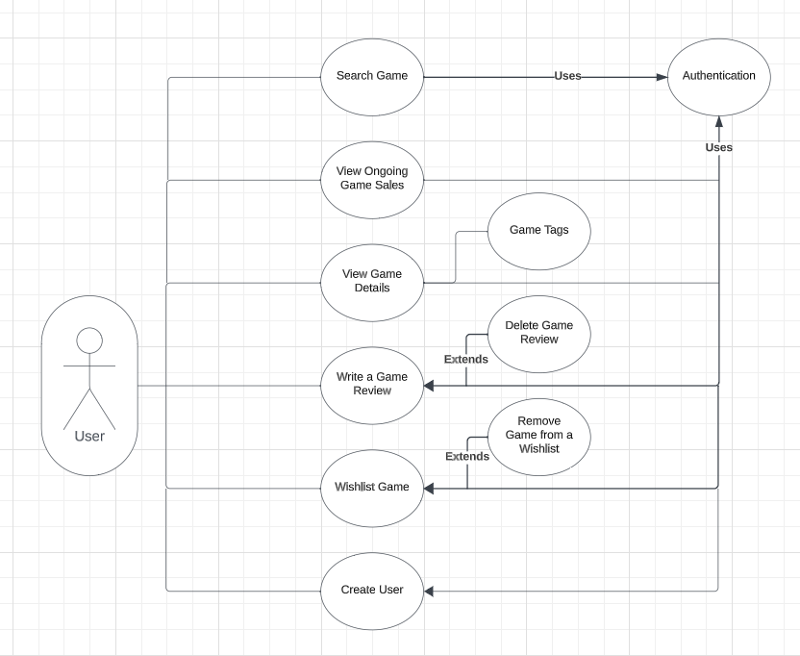

Slide 5
E/R Diagram and Schema

Slide 6
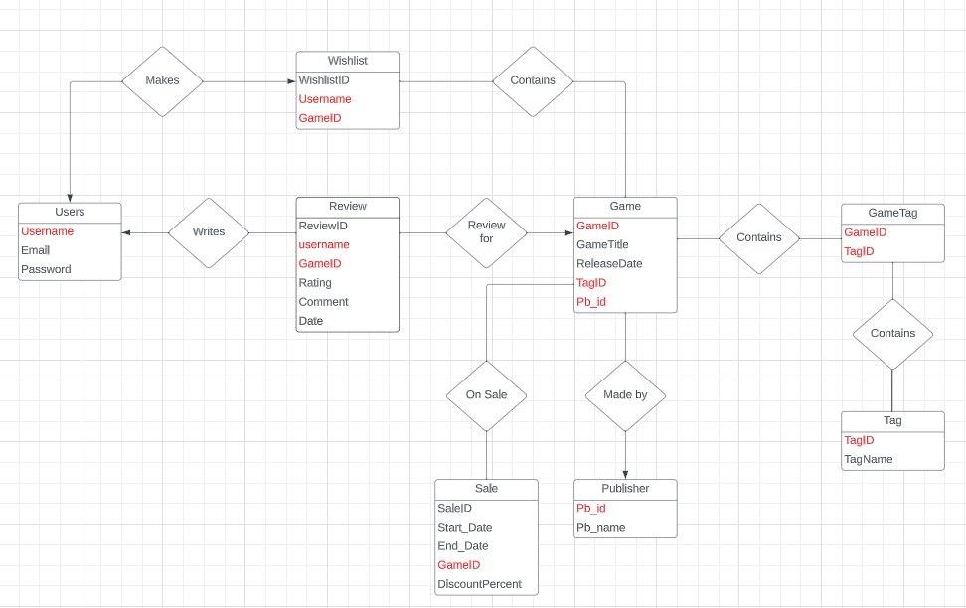

Slide 7
Implementation Details
Used HTML, CSS and a tiny bit of JS to implement our frontend.
For database handling, our backend was implemented through python; more specifically used Flask to handle user-to-database interaction.

